Slide 1
Status of MEA Acute potential issues
And whether we will pipeline and release the TSCA data

Slide 2
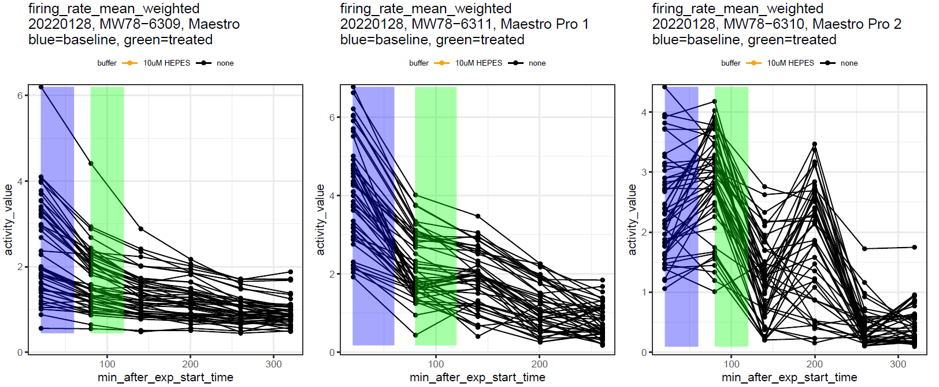
The issue
We thought there was a strong "DMSO effect“ that was causing the activity to decrease over time
But, K & T did some experiments and found that there is actually a significant decrease in activity as the plate sits, even with nothing added at all!

Slide 3
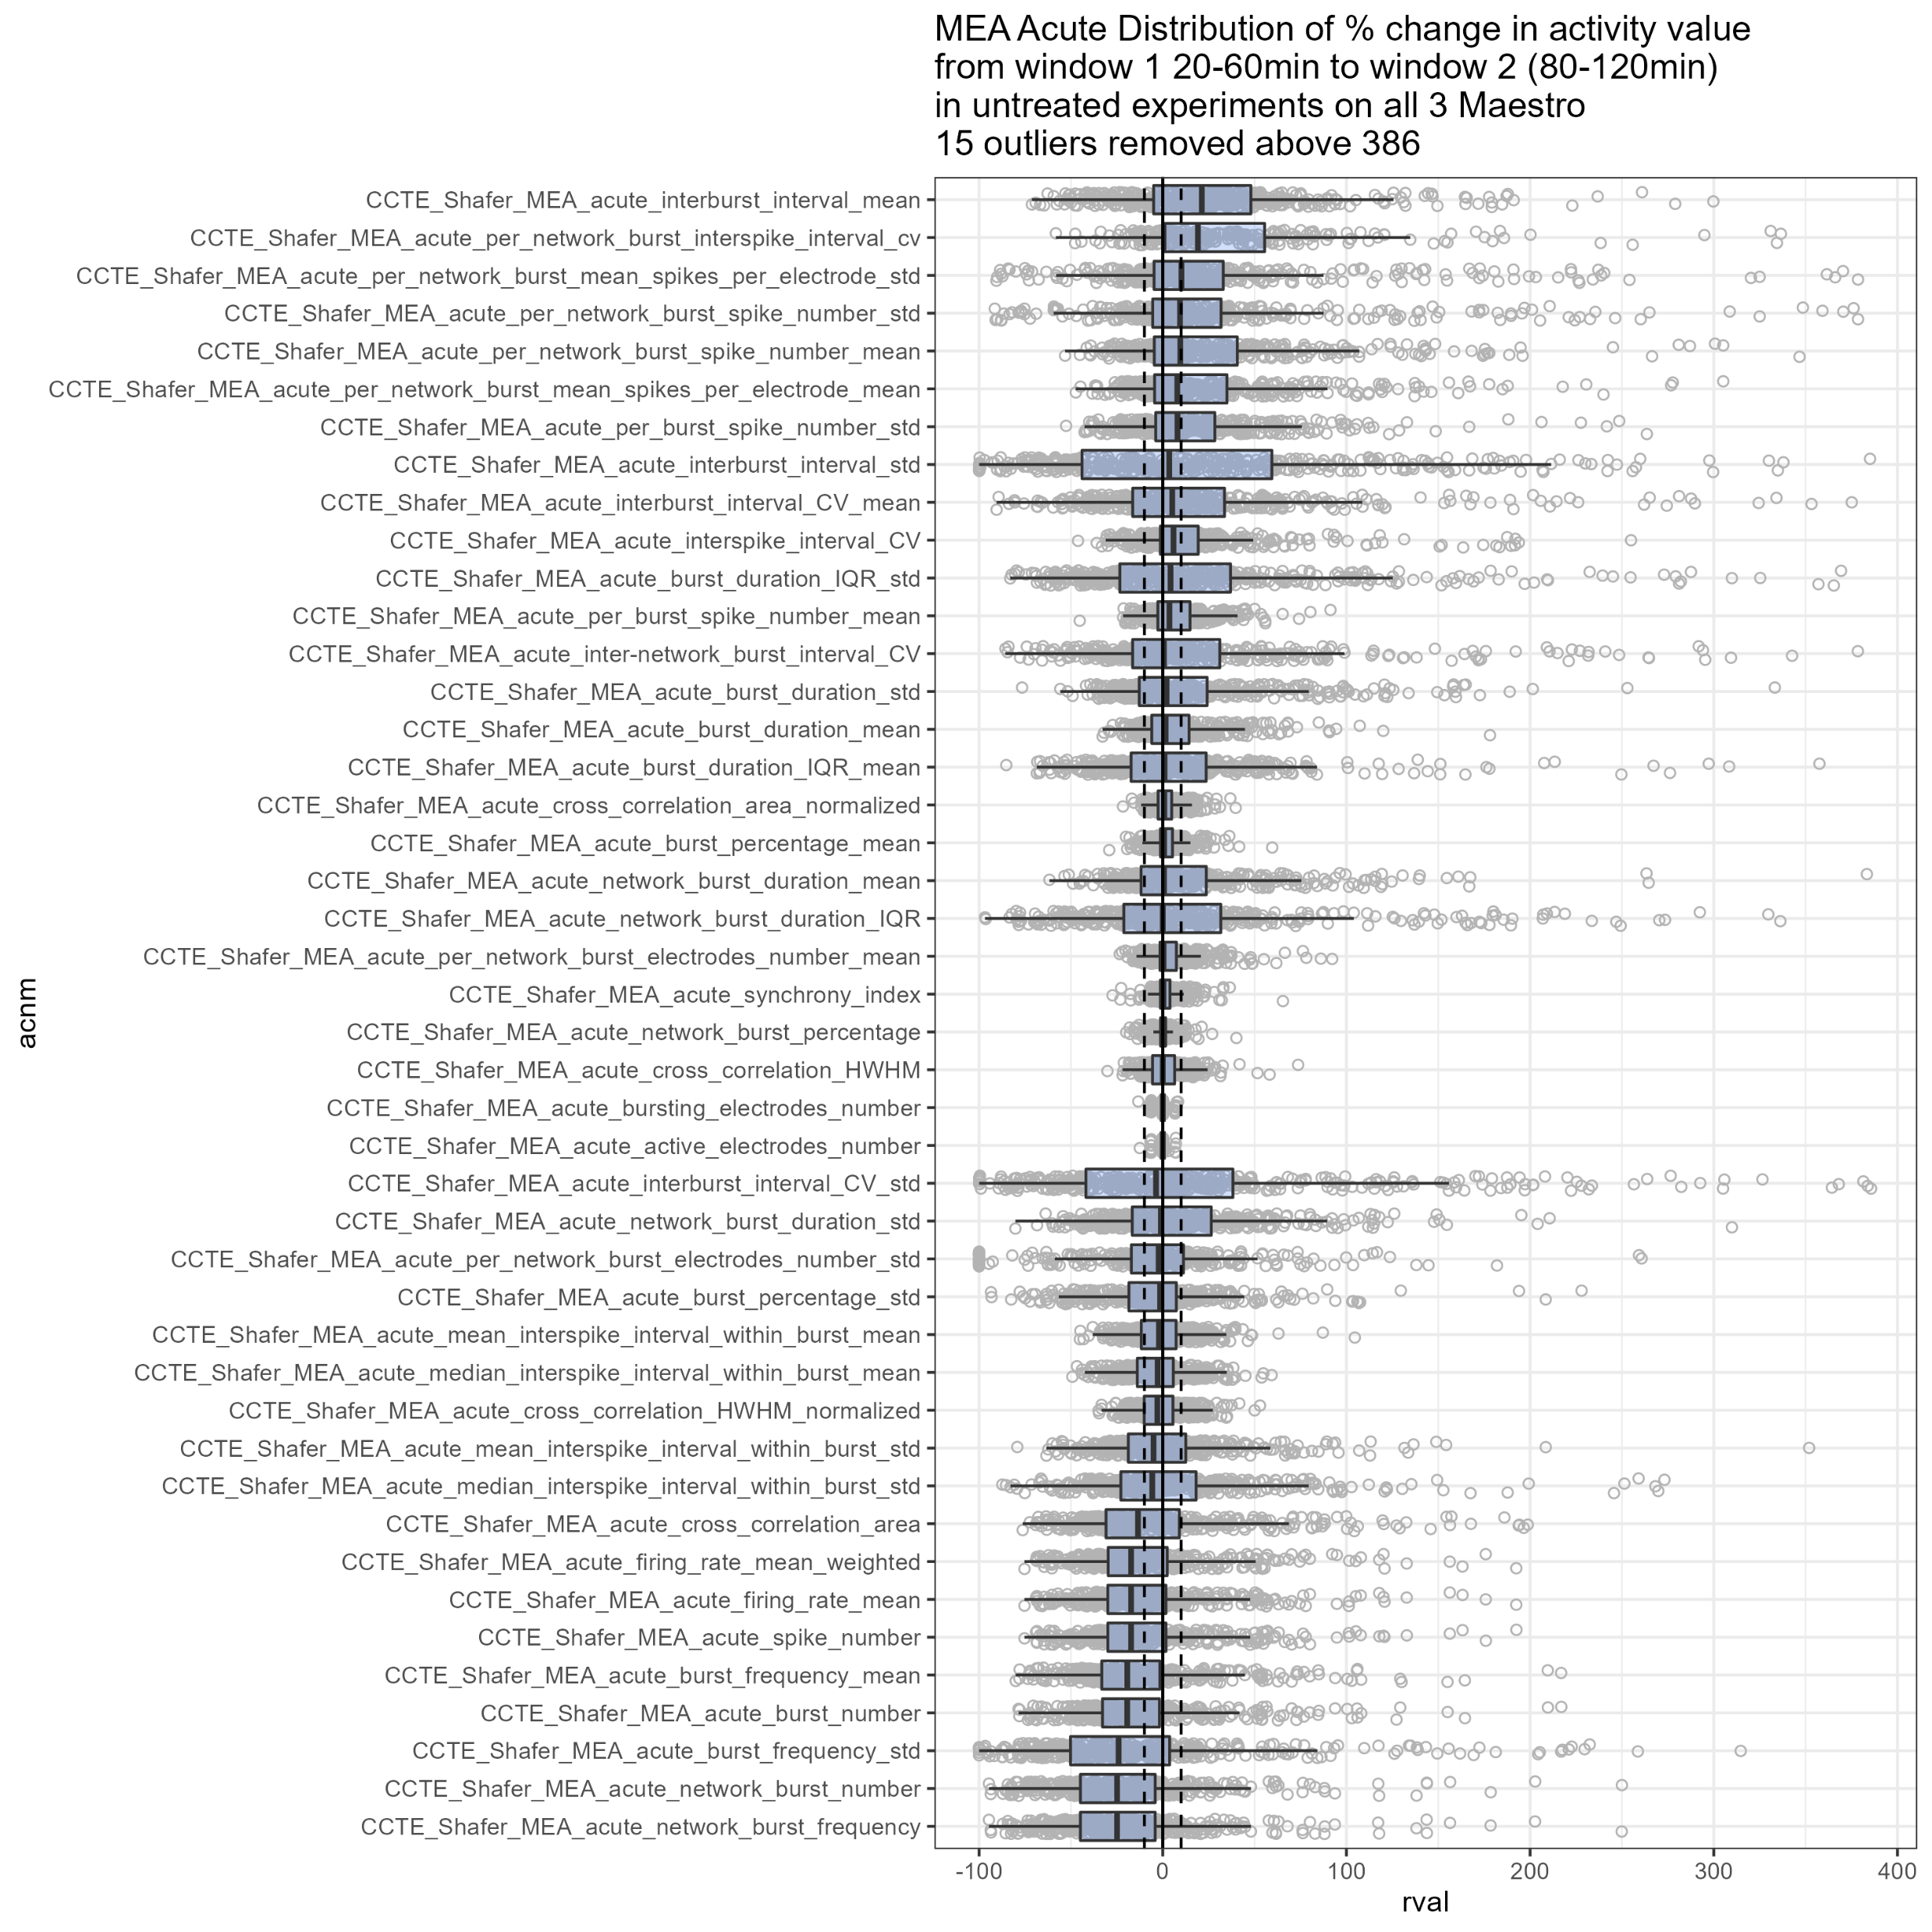
Variable effects on endpoints
Results from the “Baseline Decline” experiment, from all 3 Maestros
Theoretically, we would expect a 0% change in activity from 20 - 120 minutes if no treated added
Dashed lines +/- 10%
Largely endpoints that measure general activity level, plus burst frequency SD

Slide 4
My thoughts
On one hand, normalizing to controls should solve the problem
BUT, if the activity at baseline decreases to nearly 0, then maybe we would miss chemicals that would normally cause e.g. a 20% decrease in activity?
Has this always been going on, or do we think this is a new issue?
If it's always been going on, then I see it as less of an issue. It is just one of the shortcomings of the assay.
If the decline in baseline is a new phenomena, then we have more of a problem for assay interpretation.

Slide 5
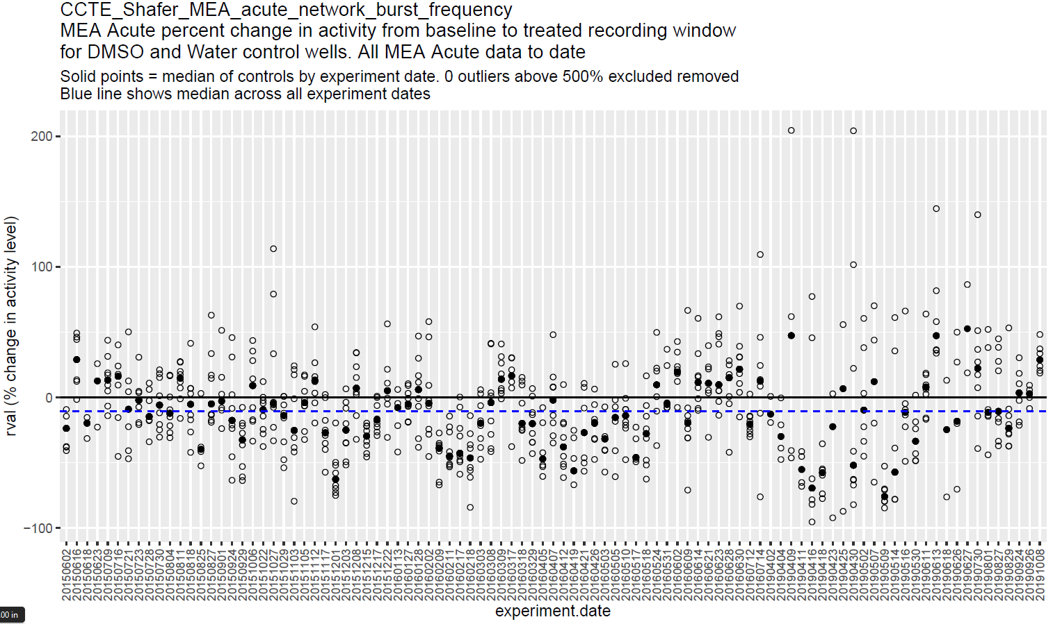
Trends over time for DMSO and water controls
June 2015 – Oct 2019
Assay protocols may have changed slightly
Different maestro
Possibly longer interval between baseline, dose, and treated recordings?
Possibly different administration methods of DMSO?
Trends
Increase in noise in recent times
I’m NOT seeing a new emergence of controls dropping out
This does NOT include the TSCA data

Slide 6
Status of TSCA data?
Where I left off: there was some non-standardness in how the baseline versus treatment files are named.
I have ideas of how to get this info in a much more robust way than just relying on K & T to manually name the files consistently (I think I can scrape the info from the file body?)
Def doable, just need to write the code and test it
SO -> I don't have the % change data yet here
So I don't know if the % change was worse here or not (and if that’s why K & T started re-investigating this issue)

Slide 7
Notes from discussion with Tim September 13, 2022
Tim agreed that the decline in baseline activity just affects the sensitivity of the assays.
"I'd like to be able to fix this, but that's [an assay issue], not a data analysis issue."
(and I agree that it just affects the sensitivity, since we do normalize to controls now!)
Based on Tim's initial intuition and graphs I showed of activity over time from June 2015 - October 2019, it doesn't seem like there is a clearly newly-emerging issue of a decrease in activity
So Tim is inclined to pipelien the data as-is
But he also agreed it would be helpful to see how the TSCA data fits in, to see if there is a new issue emerging/if it's any different
Regardless, NTP data is higher priority than the TSCA data
Tim decided to move the TSCA data subproduct delivery due date to the next strap.
So we will return to this in October.
Next step:
Prepare the TSCA data (left off with new function to identify treated vs baseline recording file names) (see git branch “experimental 1”, new “run_type_determination” function and test/R/experimenting)with_run_type_determination_2022-09-14.R). To ultimately replace run_type_determination in current dat1 function).
See if the decline in baseline (or really, controls) is significantly greater than it was in the past for any endpoints (is that why K & T noticed this? Or just because they happened to notice the decline with this assay and had the bandwidth to investigate?)
If not, then release to be pipelined.
If yes, then discuss with Tim again. Is this data usable/informative, inlight of the assay as a whole?

